Slide 1
Moderation and Mediation lab activity
Jamil Palacios Bhanji

Slide 2
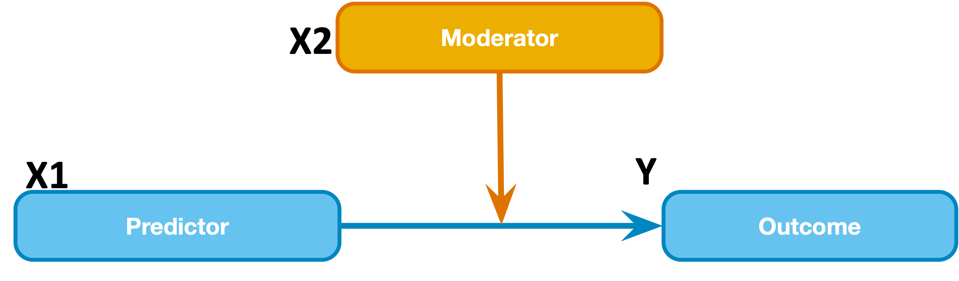
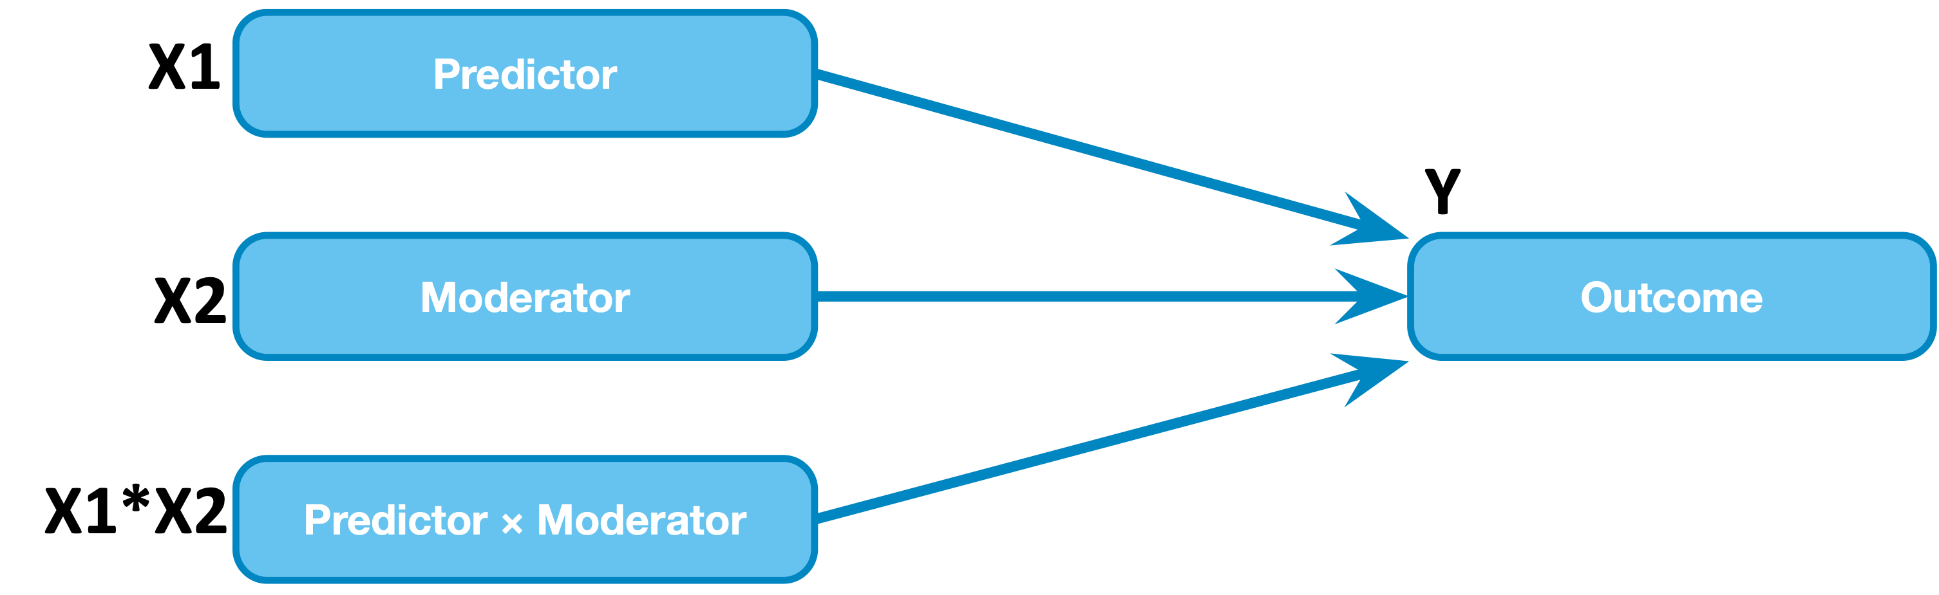
Moderation model
it’s just a regression, with an interaction term composed of the product of two (or more) other terms
Y = b₀+ b₁X1+ b₂X2 + b₃X1*X2
b₁ and b₂ main effect terms should always be included with the interaction but be careful w/ interpretation because b₁ depends on b₂ level and vice versa when interaction is present
b₃ is the estimate of the interaction effect
A change of one unit in X1*X2 predicts a change of b₃ in Y (that’s hard to picture, so the activity will guide you through visualization)

Slide 3
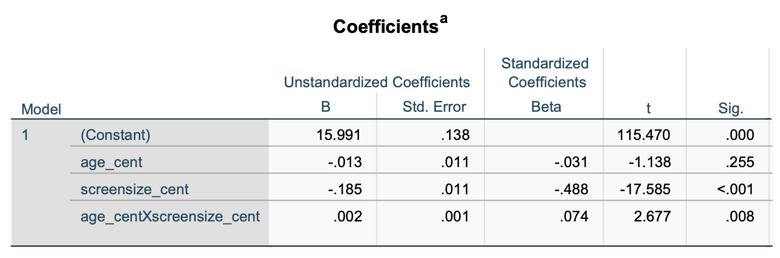
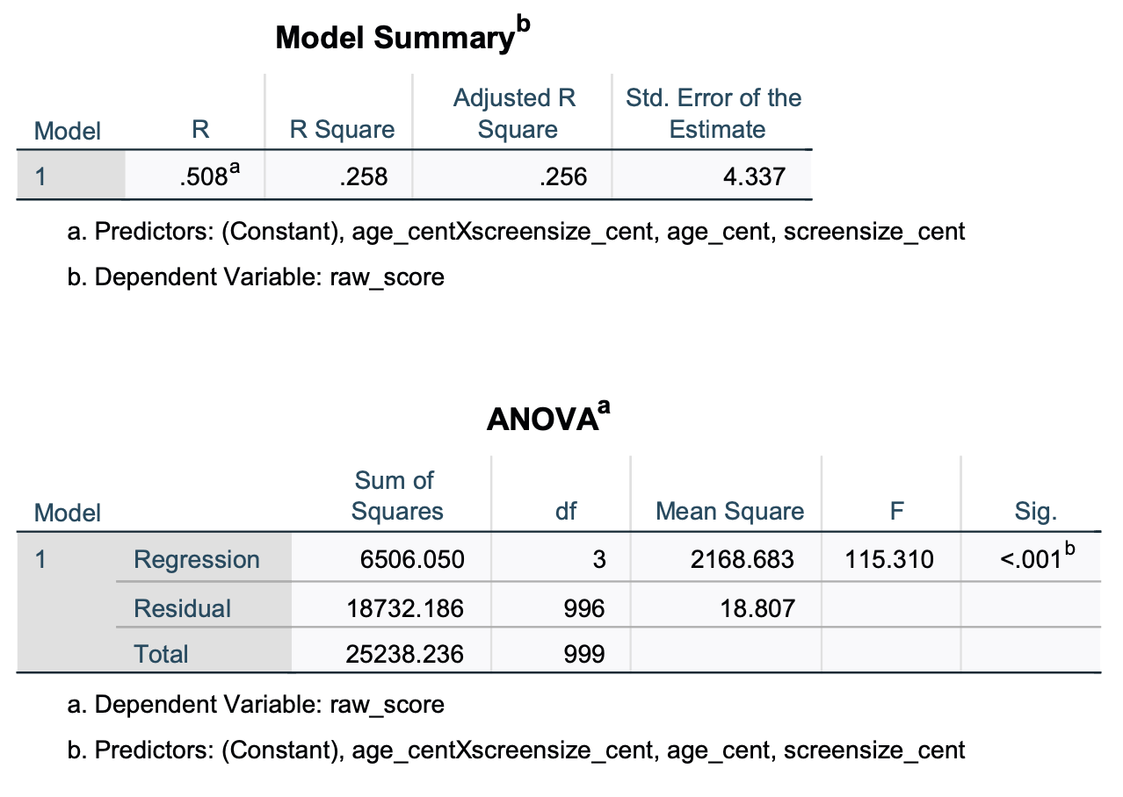
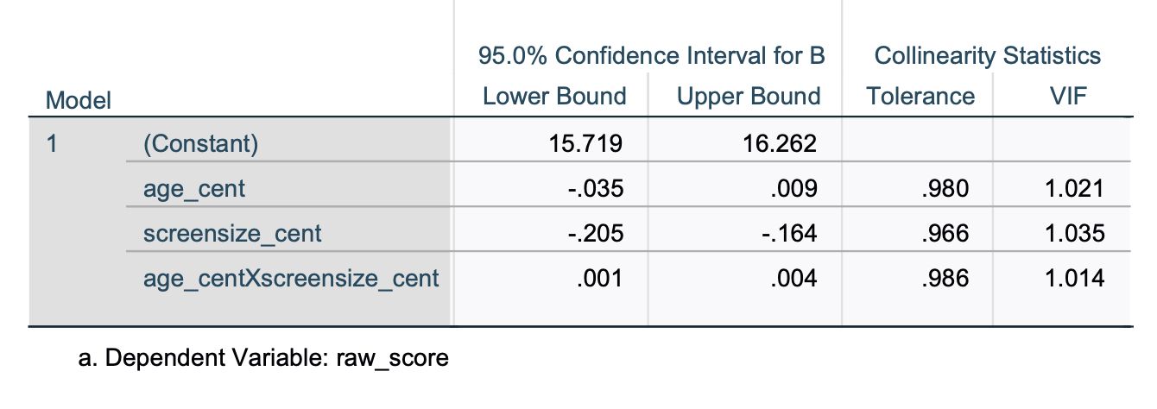
Moderation model output
SPSS linear regression – exactly the same as the lin regression output you looked at last week

Slide 4
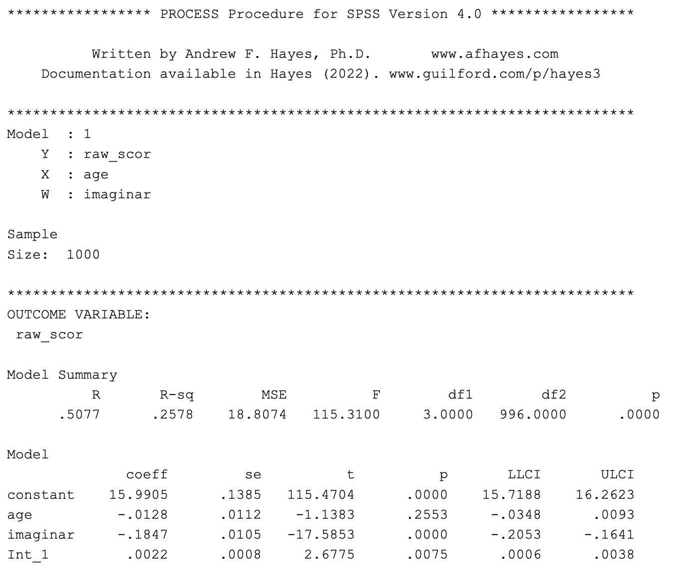
Moderation model output
PROCESS (model = 1) – same stats, reformatted
Notes:
explain model numbers

Slide 5
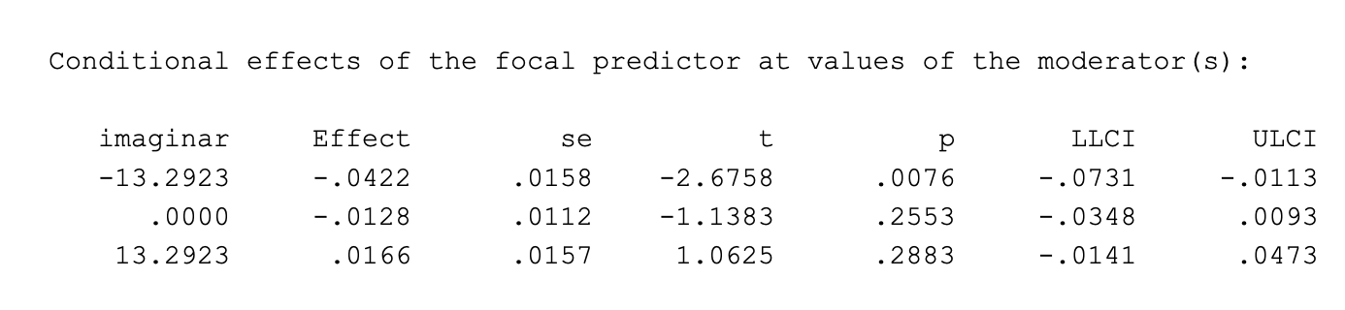
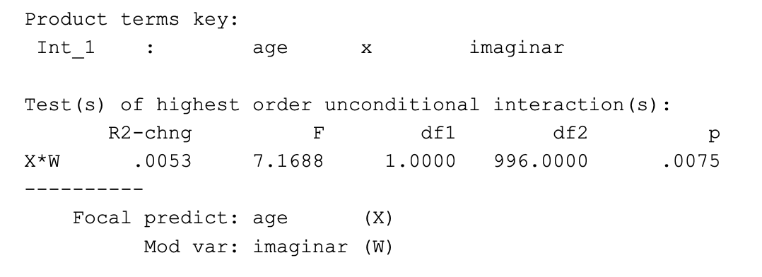
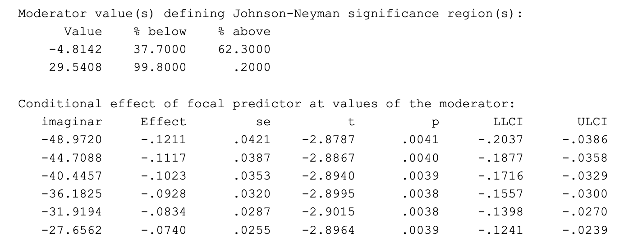
Moderation model output
PROCESS (model = 1) – stuff that is not in the regular SPSS regression output
Simple slopes (effect of X1 at distinct levels of X2)
R squared change for full model vs model w/o the interaction
X2
mean - SD
mean
mean + SD
Regions of significance (Johnson-Neyman)

Slide 6
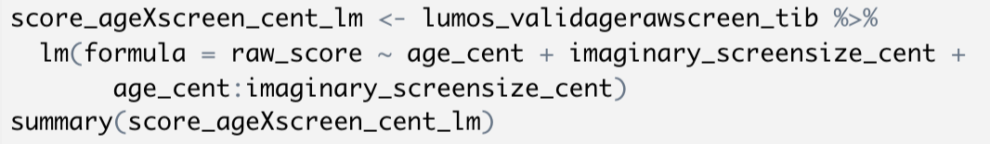
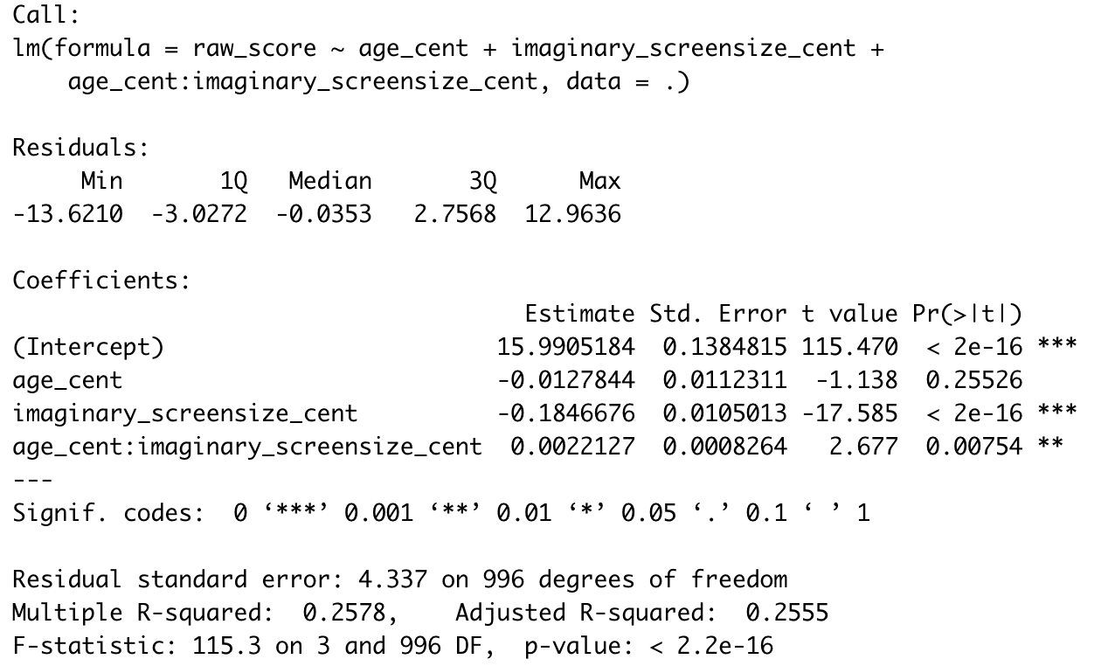
Moderation model output
R lm()– exactly the same as the output you looked at last week

Slide 7
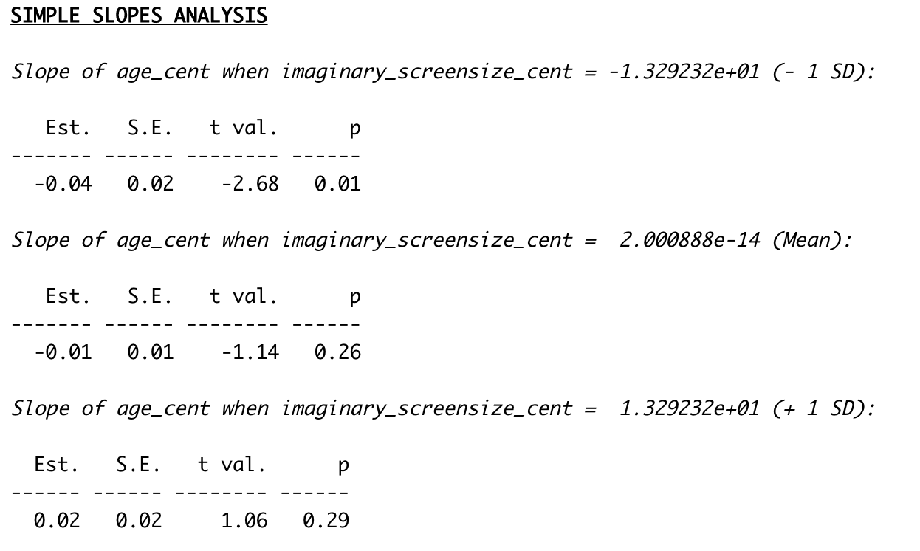
Moderation model output
R simple slopes (using interactions::sim_slope

Slide 8
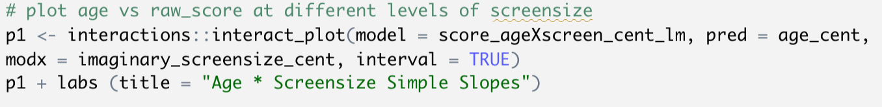
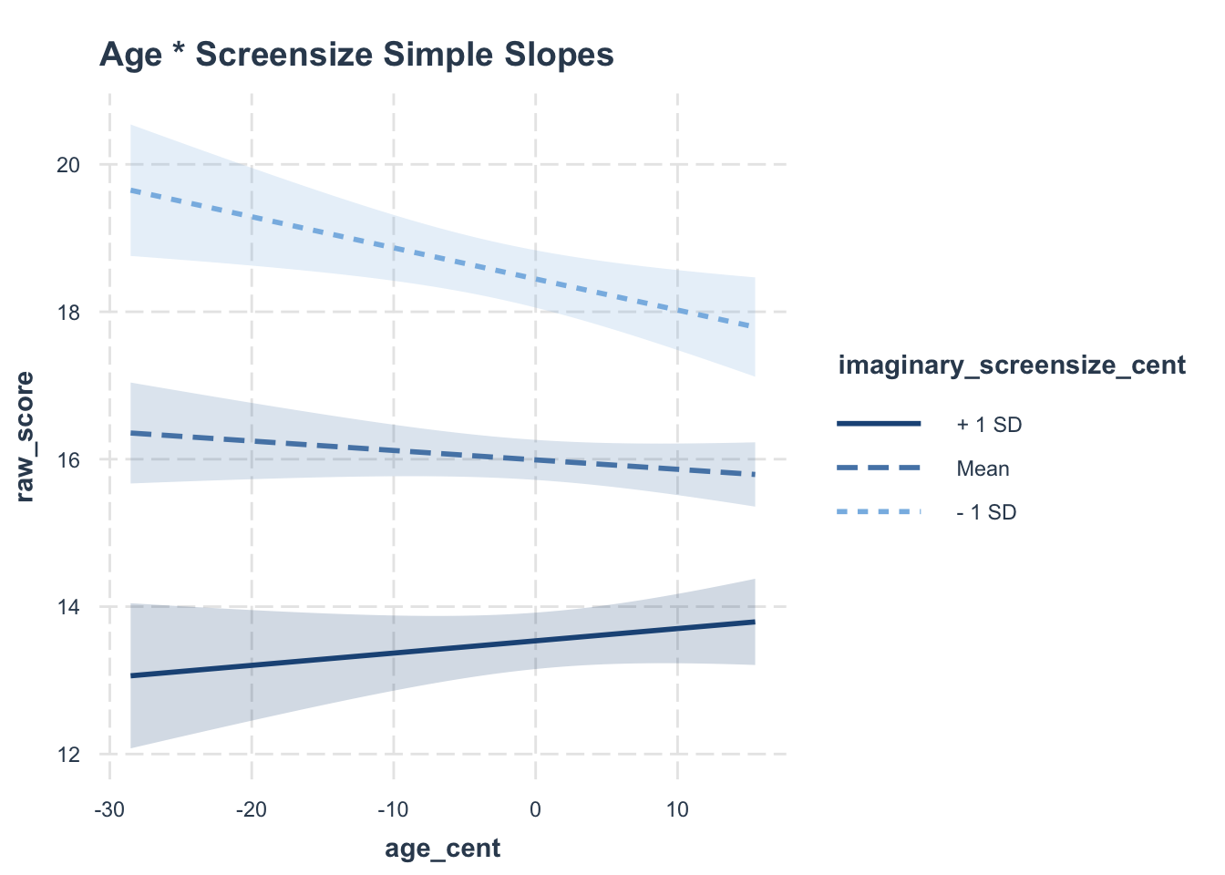
Moderation model - visualization

Slide 9
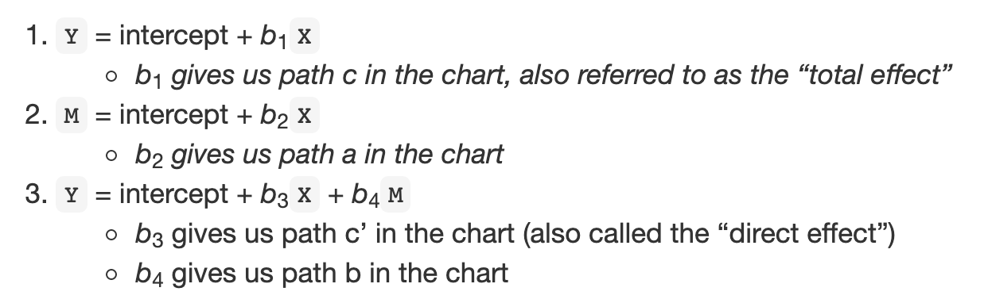
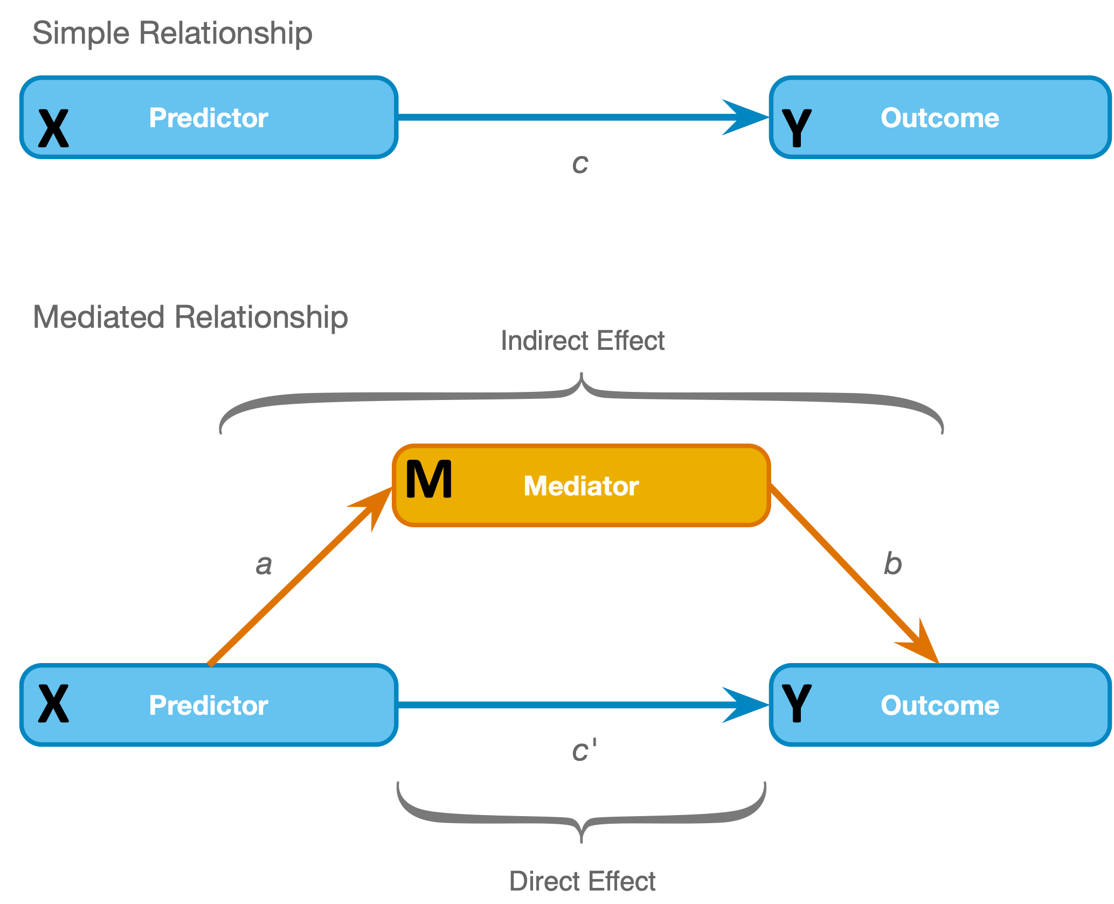
Mediation model (using PROCESS)

Slide 10
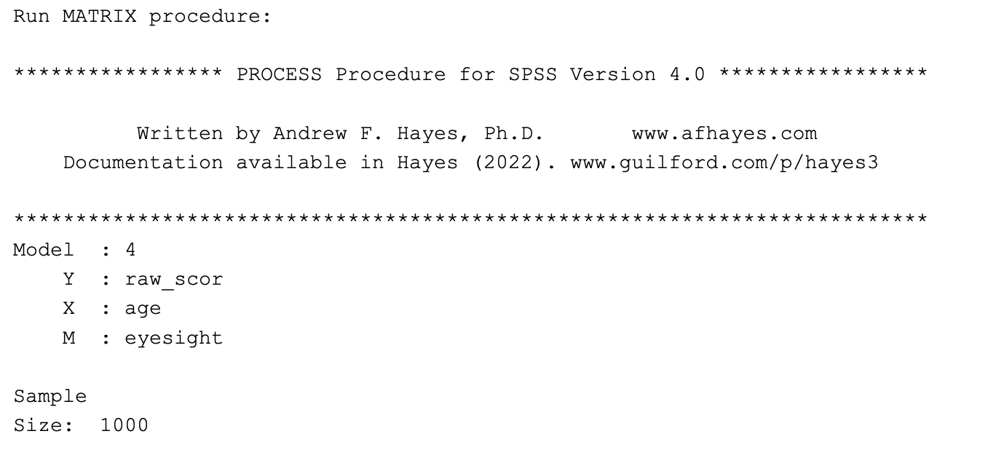
Mediation model (using PROCESS)- output
basically the same in SPSS or R

Slide 11
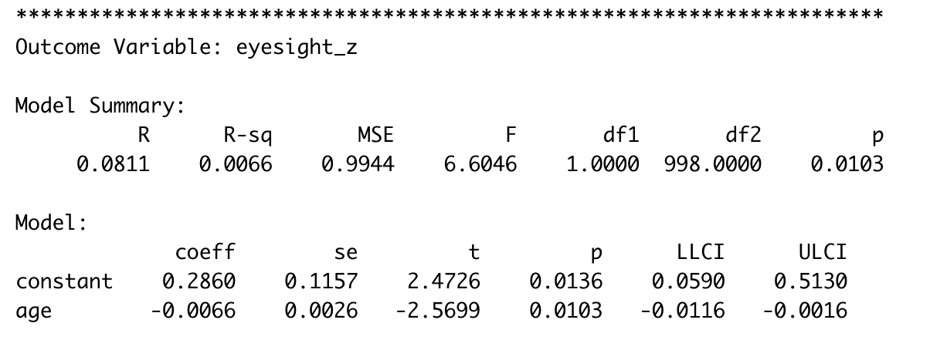
Mediation model (using PROCESS)- output
path a

Slide 12
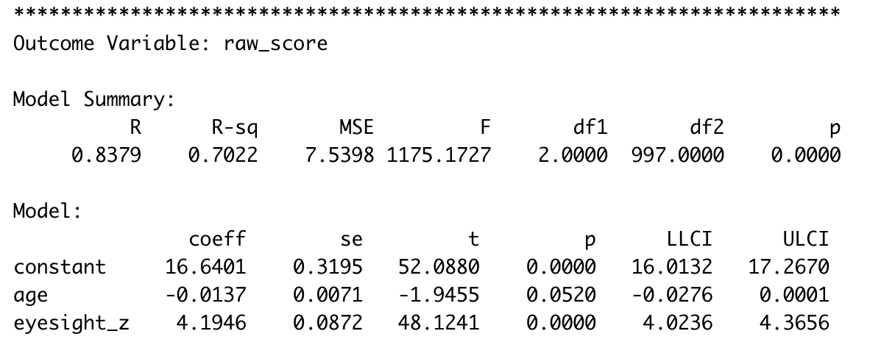
Mediation model (using PROCESS)- output
path c’
path b

Slide 13
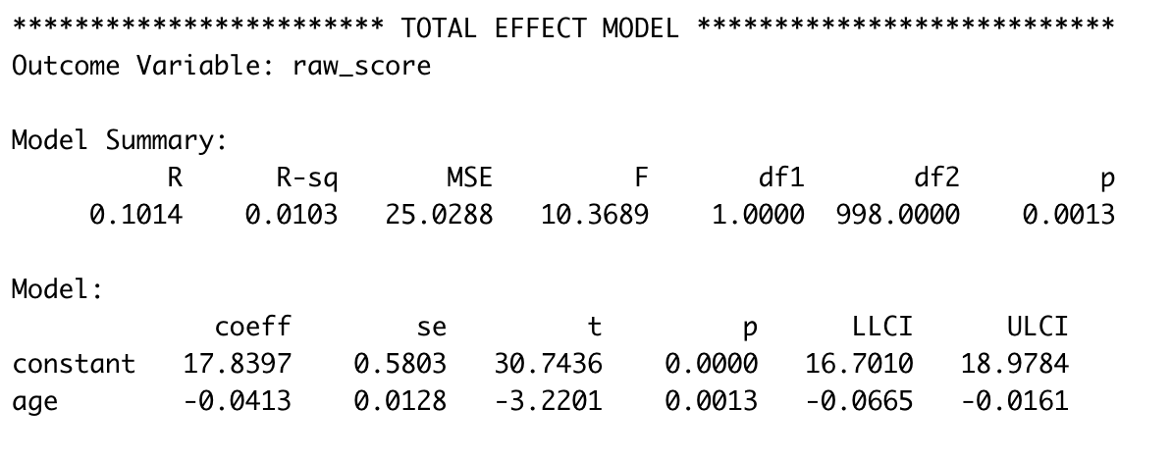
Mediation model (using PROCESS)- output
path c

Slide 14
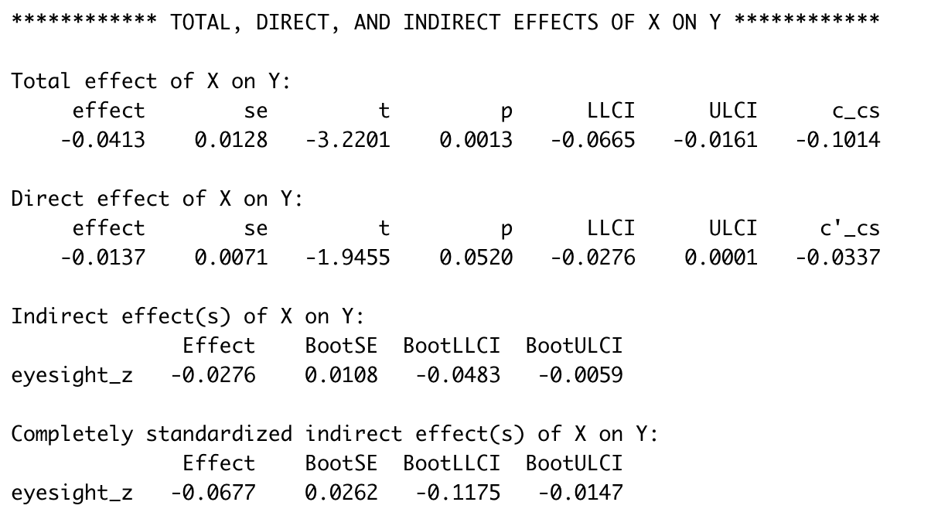
Mediation model (using PROCESS)- output
path c
path c’
path ab
path ab standardized
Notes:
From Fairchild & McDaniel (2017): Best (but oft-forgotten) practices: mediation analysis. The American Journal of Clinical Nutrition,https://doi.org/10.3945/ajcn.117.152546 “cross-sectional sample data can indicate support for mediation effects when there is no true mediation process in the population (92). These findings are not to say that it is impossible to examine mediation hypotheses with data that are collected at one point in time; however, there is an onus on the researcher to provide a compelling rationale that temporal ordering of the examined variables is correct (93, 94). Indeed, Kenny and colleagues (10, 11) emphasized in early work that mediation analysis should not be conducted unless the temporal ordering of the variables is clear. Examining mediation hypotheses with cross-sectional data may be reasonable, for example, if measured variables can reflect nearly instantaneous processes, such as may be the case with some pharmacokinetics work, or imply timing by nature of their construction (18, 93). Consider a research scenario in which the mediating role of parental food monitoring during an individual’s adolescence (M) is posited to explain the impact of parental childhood obesity (X) on subjects’ current obesity status (Y). Although one may garner this information from participants at a single measurement occasion, it may be sensible to argue temporal precedence of the variables in a causal chain given the chronological nature of the constructs. Researchers should be mindful of potential retrospective reporting bias in these cases, however.”

Slide 15
From Fairchild & McDaniel (2017): Best (but oft-forgotten) practices: mediation analysis. The American Journal of Clinical Nutrition,https://doi.org/10.3945/ajcn.117.152546 “cross-sectional sample data can indicate support for mediation effects when there is no true mediation process in the population (92). These findings are not to say that it is impossible to examine mediation hypotheses with data that are collected at one point in time; however, there is an onus on the researcher to provide a compelling rationale that temporal ordering of the examined variables is correct (93, 94). Indeed, Kenny and colleagues (10, 11) emphasized in early work that mediation analysis should not be conducted unless the temporal ordering of the variables is clear. Examining mediation hypotheses with cross-sectional data may be reasonable, for example, if measured variables can reflect nearly instantaneous processes, such as may be the case with some pharmacokinetics work, or imply timing by nature of their construction (18, 93). Consider a research scenario in which the mediating role of parental food monitoring during an individual’s adolescence (M) is posited to explain the impact of parental childhood obesity (X) on subjects’ current obesity status (Y). Although one may garner this information from participants at a single measurement occasion, it may be sensible to argue temporal precedence of the variables in a causal chain given the chronological nature of the constructs. Researchers should be mindful of potential retrospective reporting bias in these cases, however.”

